Slide 1

Study in New York University
For IBM Data Science final assignment
Final assignment for IBM Data Science

Slide 2

Introduction
I will study at New York University next year, so I use the project to find a better place to live.
Who can benefit from the project?
Students
Traveler
Employer
Any people who want to explore a specified place

Slide 3

Data
Crime data
Neighborhoods data
Foursquare API to get food venues

Slide 4
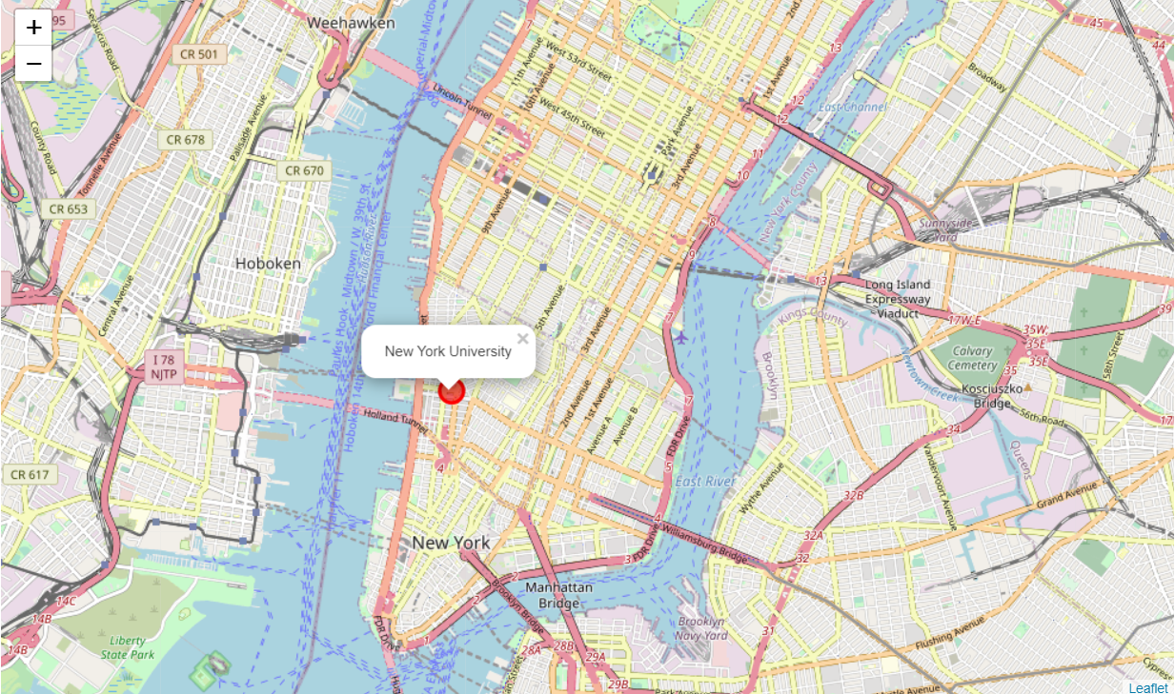
1. New York Map

Slide 5
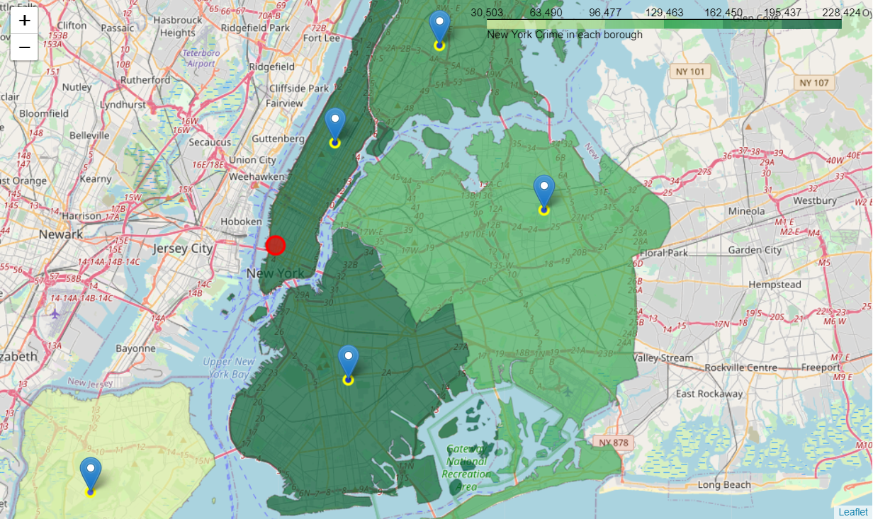
2. Crime in each borough

Slide 6
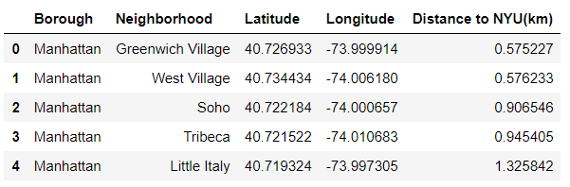
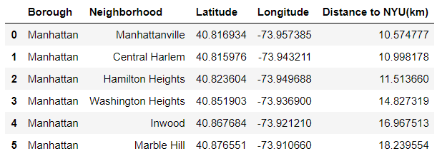
3. Distance from University
Select neighborhoods within 10km from University
Neighborhoods that no loner considered with more than 10km to University

Slide 7
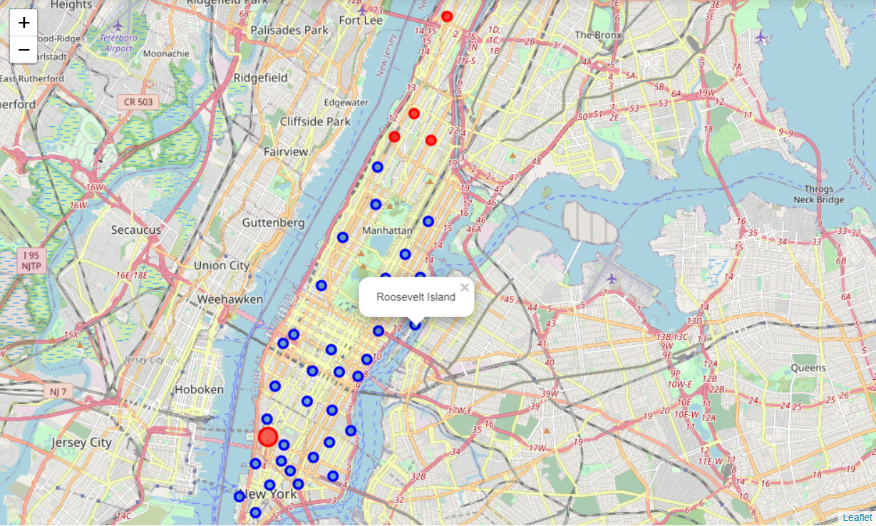
4. Visualization for neighborhoods
Choosed(<10km)
Refused(>10km)

Slide 8
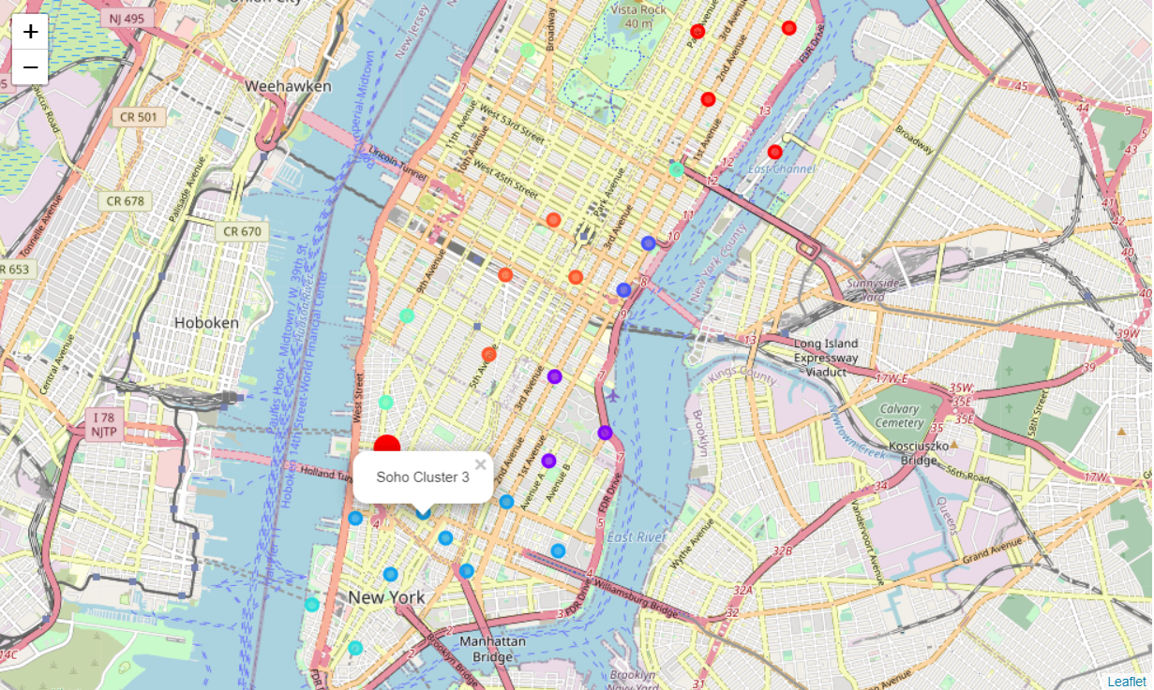
5. Clustering by food venues
K-Means Algorithms
k = 10
Choose cluster 3

Slide 9
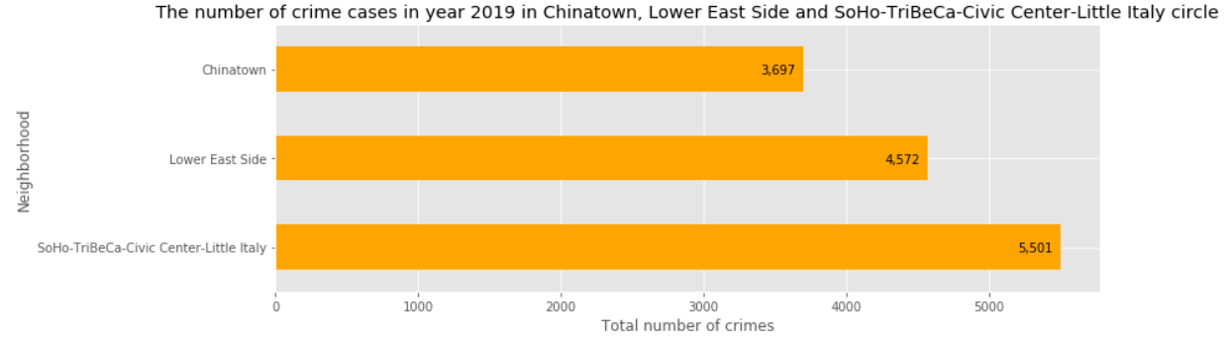
6. Use crime data to decide
Choose Chinatown!

Slide 10
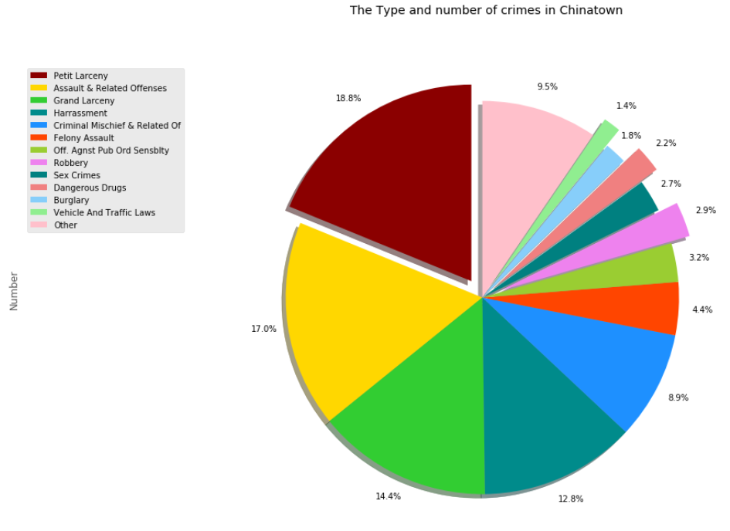
7. Crime categories in Chinatown
It is safe to live in Chinatown

